Slide 1
Utilizing RPG's in Creative Writing
Presented by:
Commodore R.J. Hanson
www.bloodlinesreforged.com
rj@bloodlinesrefoged.com

Slide 2
First, a bit about your Supreme Pontiff
(for this presentation, anyway)
D&D in college in 1990 (yes, I know, three and a half decades ago)
Homebrew campaigns since 1997
Weekly gaming sessions every Saturday
Origin of the Bloodlines Reforged Saga

Slide 3
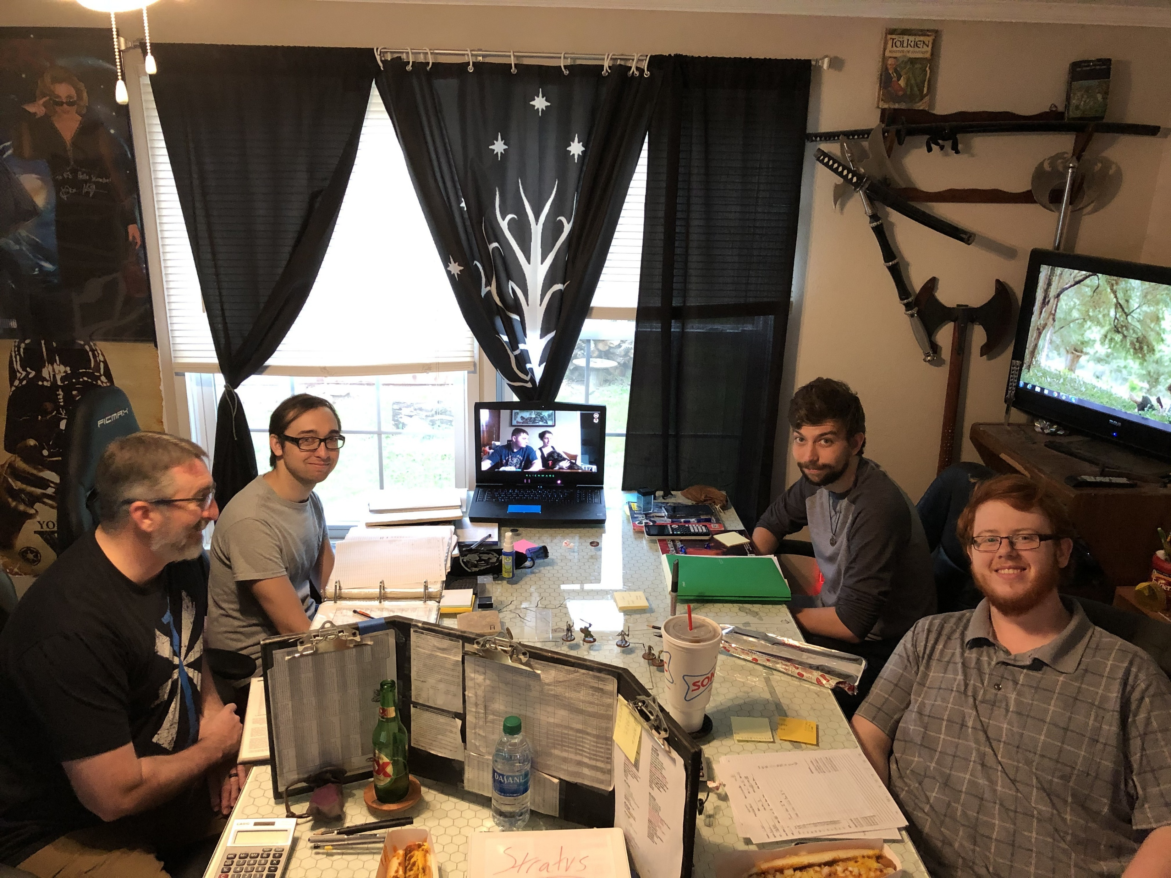
The Breakdown:
The RPG Industry
Finding a Group
Learning the Game
Homebrewing
Busting the Block
Why Are You Here?

Slide 4
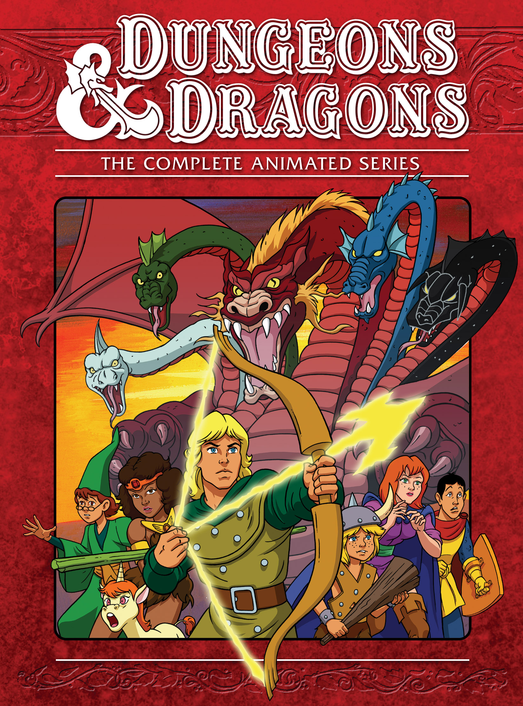

The Industry of Imagination
-Wizards of the Coast: including Dungeons & Dragons, Magic, and Magic the Gathering
-Iron Crown Enterprises: Rolemaster, etc…
-Blizzard: World of Warcraft, etc…

Slide 5
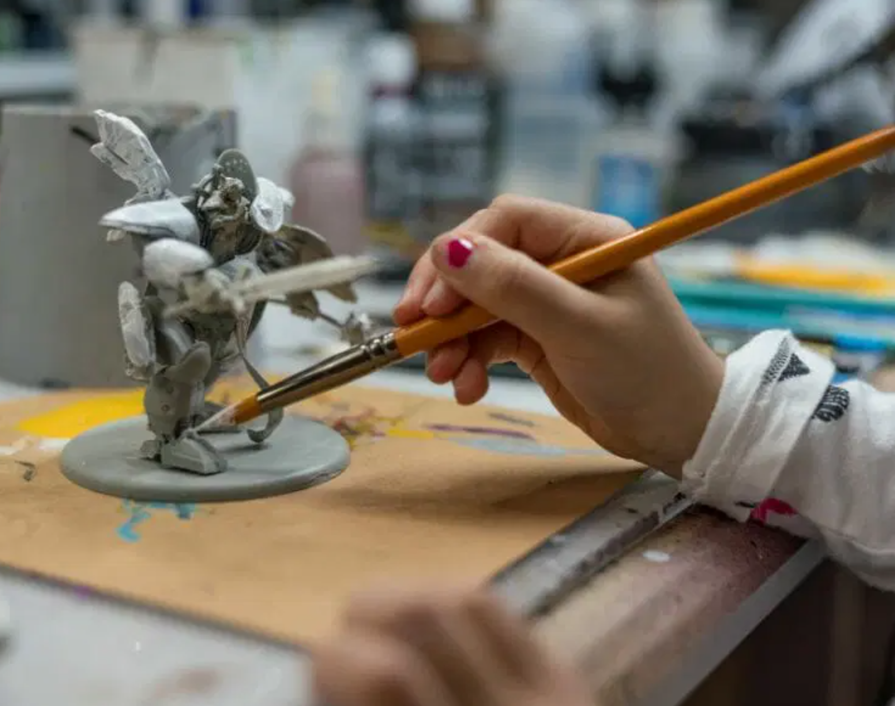
Artistic Opportunities
Game Development
Module Creation
Mini Production
Graphic Design
Cover Art
3D Modeling

Slide 6
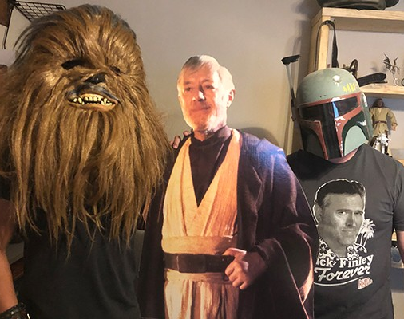
Finding your Weird
Which Game Strikes Your Fancy?
Who Else Geeks Out Over It?
Friends & Family
Public Library
Gaming Stores
Comic Cons
Online (Discord, etc…)

Slide 7
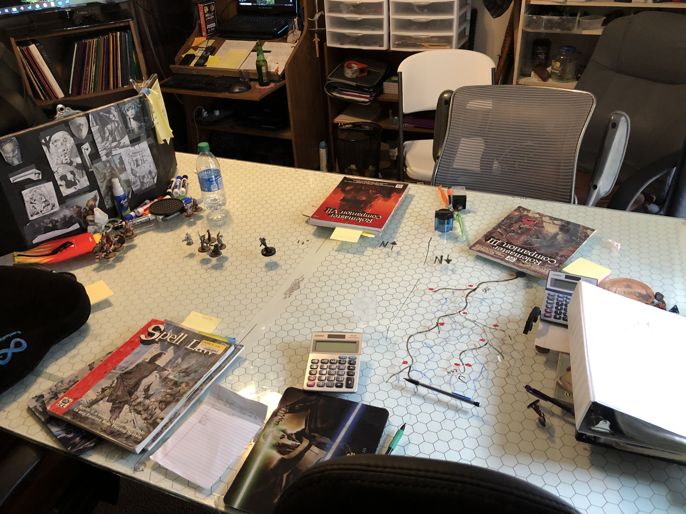
Learning the Rules
Don’t Sweat It
Most Players Are Happy to Help
Do Your Part-Buy the Books, Pay Attention

Slide 8
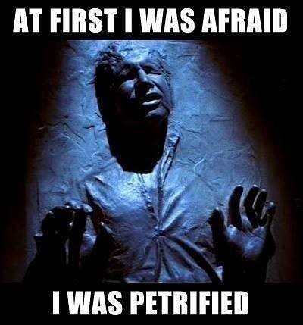
A, B, C’s of Homebrewing
Always keep your players in mind (they’re your audience)
Borders (what are they?)
Consider your badguy

Slide 9
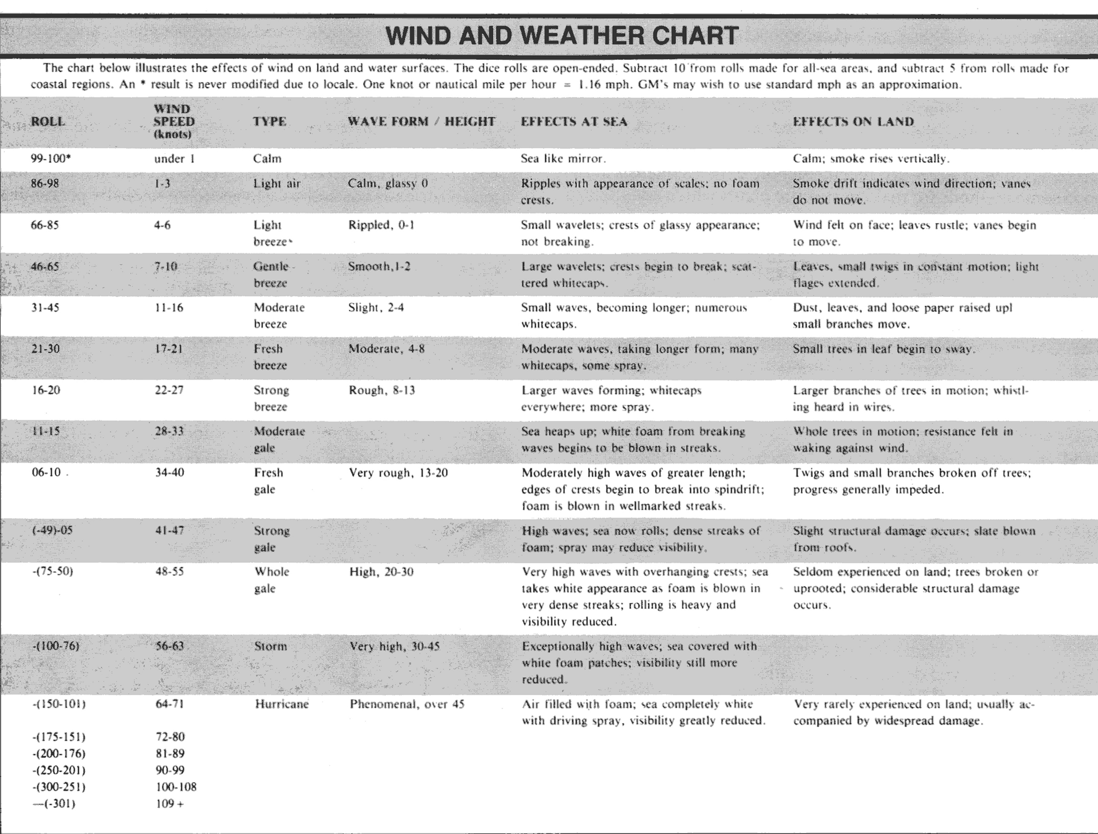
Charts & Chance
Having an iron grip on your story isn’t required.
It can actually cause you to miss some wonderful creative opportunies.

Slide 10
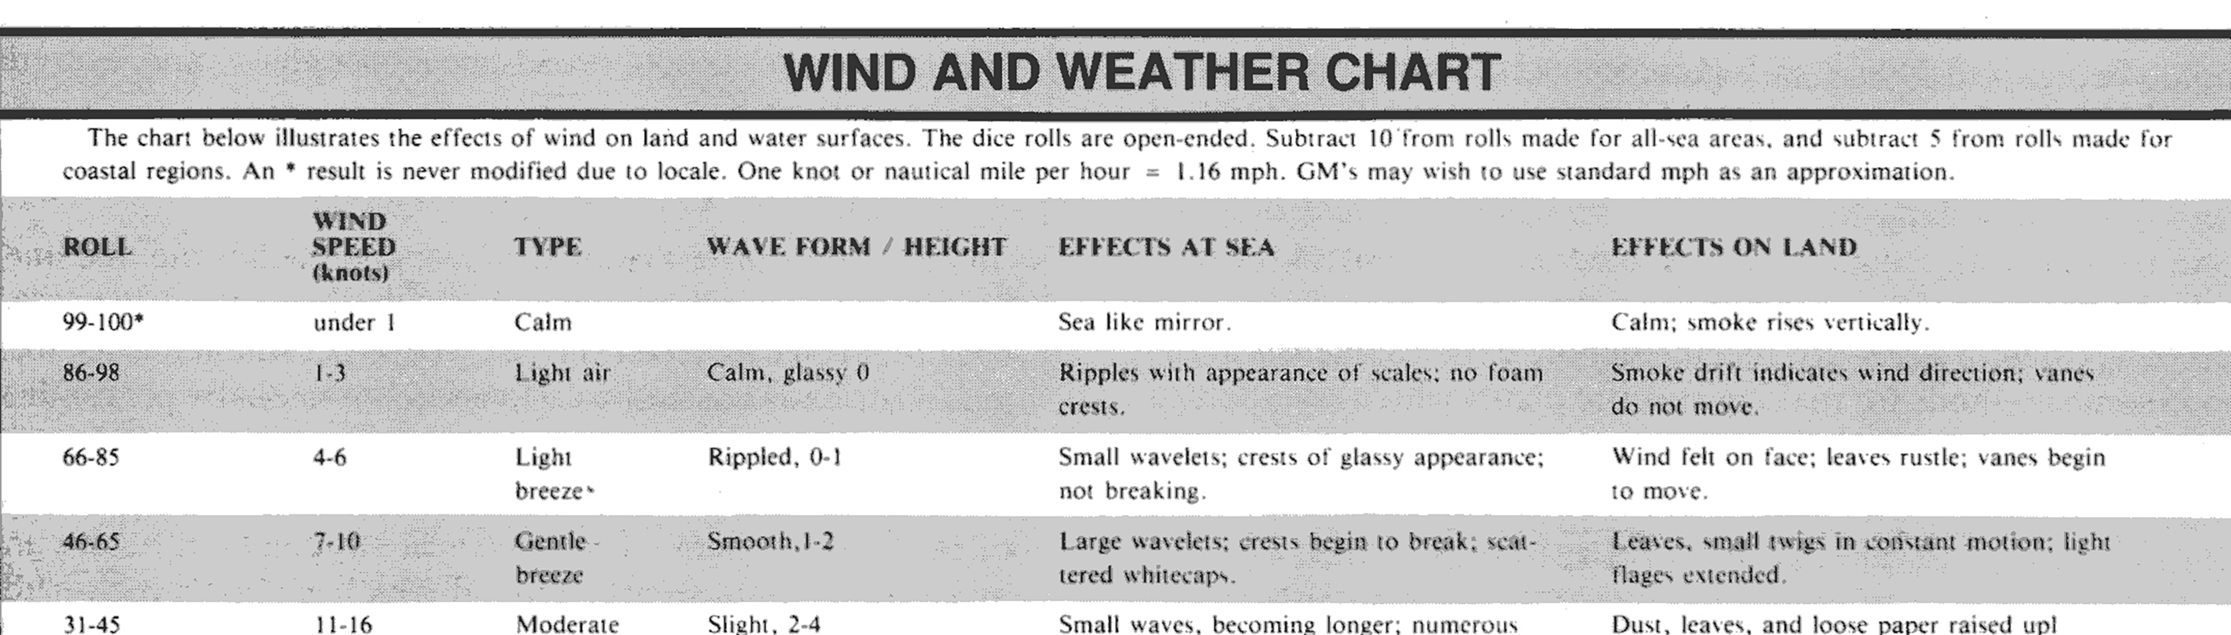
For example; a dice roll of -50 to -75 would result in wind speeds of 48 to 55 mph, waves 20 to 30 ft. in height, seldom experienced on land, trees broken or uprooted, and considerable structural damage occurs.

Slide 11
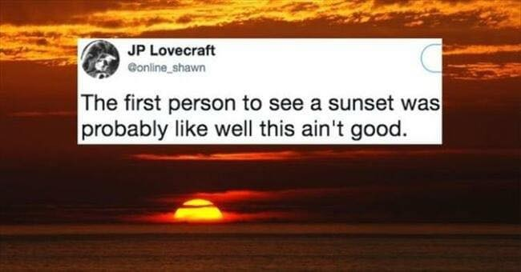
DO NOT railroad your players… or your characters. I don’t know anyone that enjoys having the physics of the universe changed just to force them into a situation.
A good DM/GM gives their players agency, some modicum of control over their environment.
A good writer does the same for their characters.
*And players can help you test-drive a plot point.

Slide 12
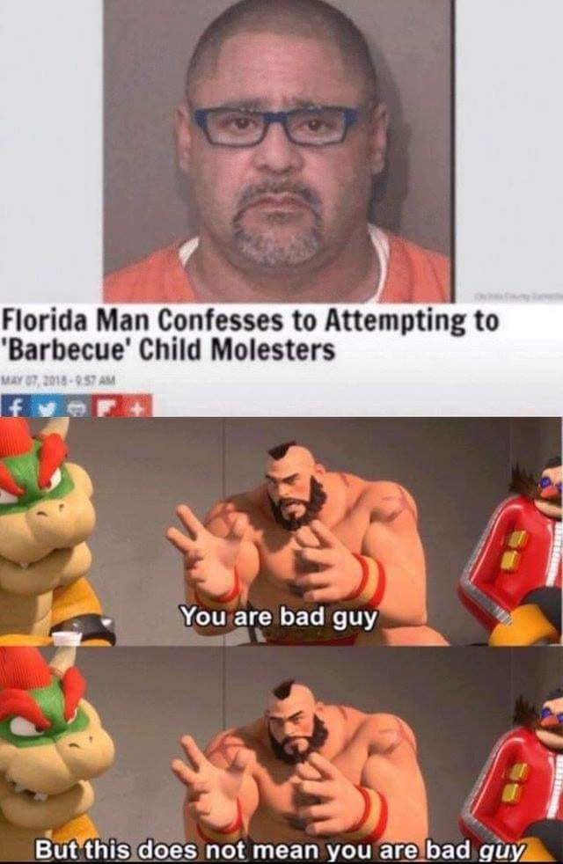
Busting the Block
What Does Your Audience Want?
Who Are Your Characters?
Why Are They Doing What They’re Doing?
What Are The Bad Guys Up To?
What Are The Ripple Effects Of Their Actions?
What Are Their Hard Moral Lines They Won’t Cross?

Slide 13
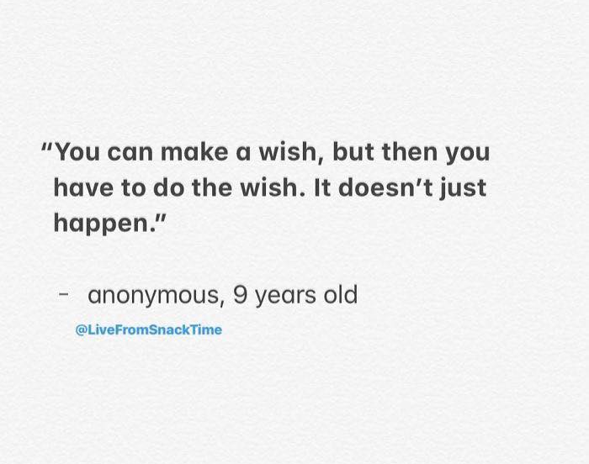
Why Are You Here?
Don’t bother reading this part.
You’re supposed to ask me questions now.

Slide 14
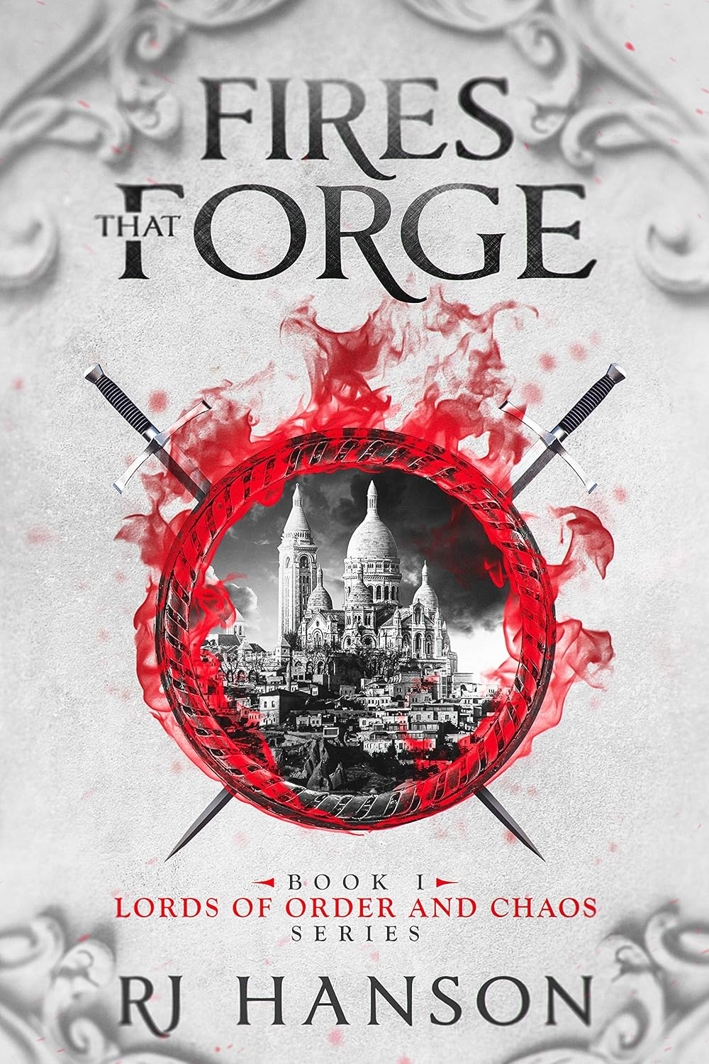
Lords of Order & Chaos
Free e-book through Kindle/Amazon today.
R. J. Hanson
rj@bloodlinesreforged.com
Facebook www.facebook.com/groups/bloodlinesreforged

